Slide 1
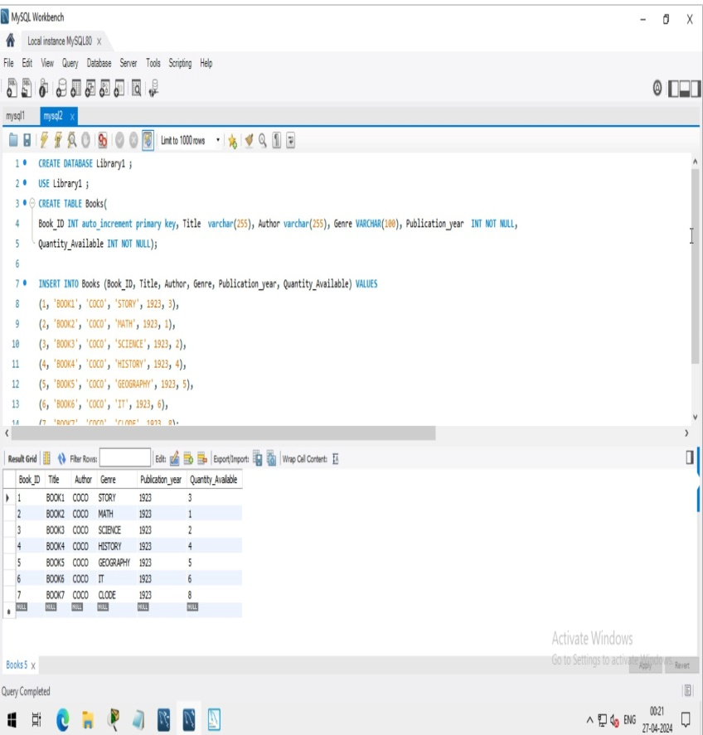

Task2-create database databasename,Use databasecreate table tablename and columns,insert in to table .
Task 4: Create a database for a local library, using the information given below: 1. Book ID (unique identifier for each book) 2. Title (the title of the book) 3. Author (the author of the book) 4. Genre (the genre/category of the book) 5. Publication Year (the year the book was published) 6. Quantity Available (the number of copies available in the library) & insert some entries here.

